Slide 1

SIGMA DELTA MODULATOR
Presented By
Shirazush Salekin Chowdhury

Slide 2

Outline
Introduction
Working Principle
Specifications
Integrator
Clocked Comparator
Top Block with Final Output
Problems and Solution
References
Questions and Answers
Difference Amplifier
Why we use Sigma-Delta ADC

Slide 3
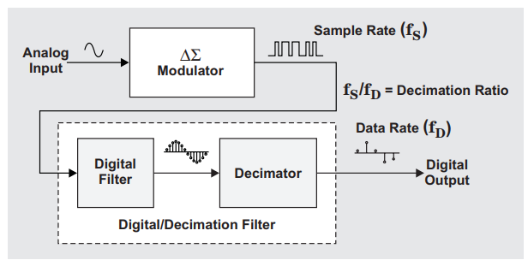
SIGMA DELTA ADC AND MODULATOR
Introduction
Sigma-delta( ΣΔ) modulation is a method for encoding
analog signals into digital signals as found in an ADC.
Delta Δ means difference. Denotes the Comparator.
Sigma Σ denotes Integrator. Summation of previous
inputs and present inputs.
An analog signal applied to the input of the converter
and is sampled multiple times, a technique known as
oversampling.
Each individual sample is accumulated over time
and “averaged” with the other input-signal samples
through the digital/decimation filter.

Slide 4
Why do we use Sigma Delta ADC?
Delta-sigma ADCs implement oversampling, decimation filtering, and quantization noise shaping to achieve high resolution
It provides excellent antialiasing filtering.
No S/H block needed.
It's also cost effective compared to SAR and Flash ADC

Slide 5
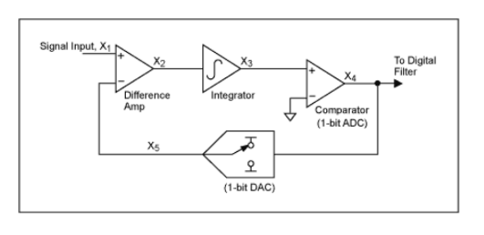
SIGMA DELTA ADC MODULATOR
Online Simulator
Working Principle :
In Sigma-Delta ADC , the input is an analog signal which is X1 & the output of DAC which is X5. Difference Amplifier (Delta) will give the output, X₂(n)=X₁(n) - X₅(n).
The output of Differential Amplifier will pass through an Integrator (Sigma) which will integrate the signal and the output will be X₃(n) = X₃(n-1)+[X₁(n) - X₅(n)].
The integrated signal will pass through the Comparator . Comparator will compare the signal with reference , The output of the comparator will be either high or low . Here Comparator basically acts as 1-bit ADC.
The output signal of comparator will pass through a 1-bit DAC whose output is X5 and acts as negative feedback of the sigma delta ADC. Again, compares with input and vice-versa.

Slide 6
Specifications
Features | Description
Technology | 55nm
Device Used | RVT
Operating Voltage | 1.2 V
Frequency range | 10KHz ~ 50KHz
Reference Voltage (Integrator, Comparator) | 600mV
External Clock Speed | 5MHz to 10MHz
Reference Current (Differential Amplifier) | 10uA
No. Of Bits | 1-bit

Slide 7
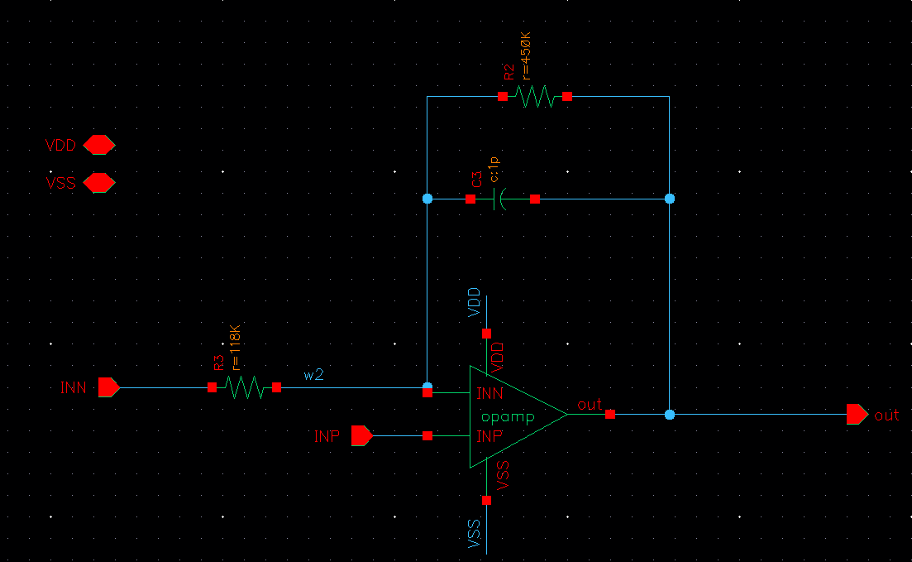
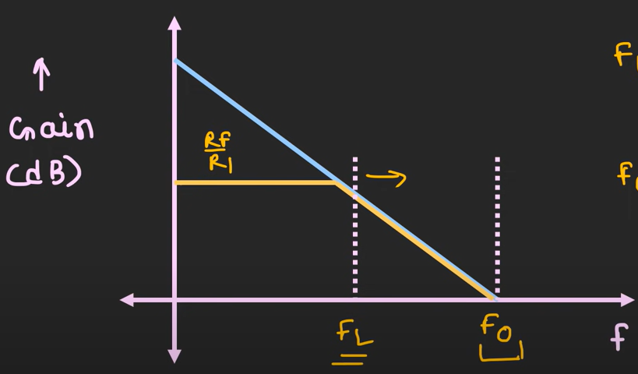
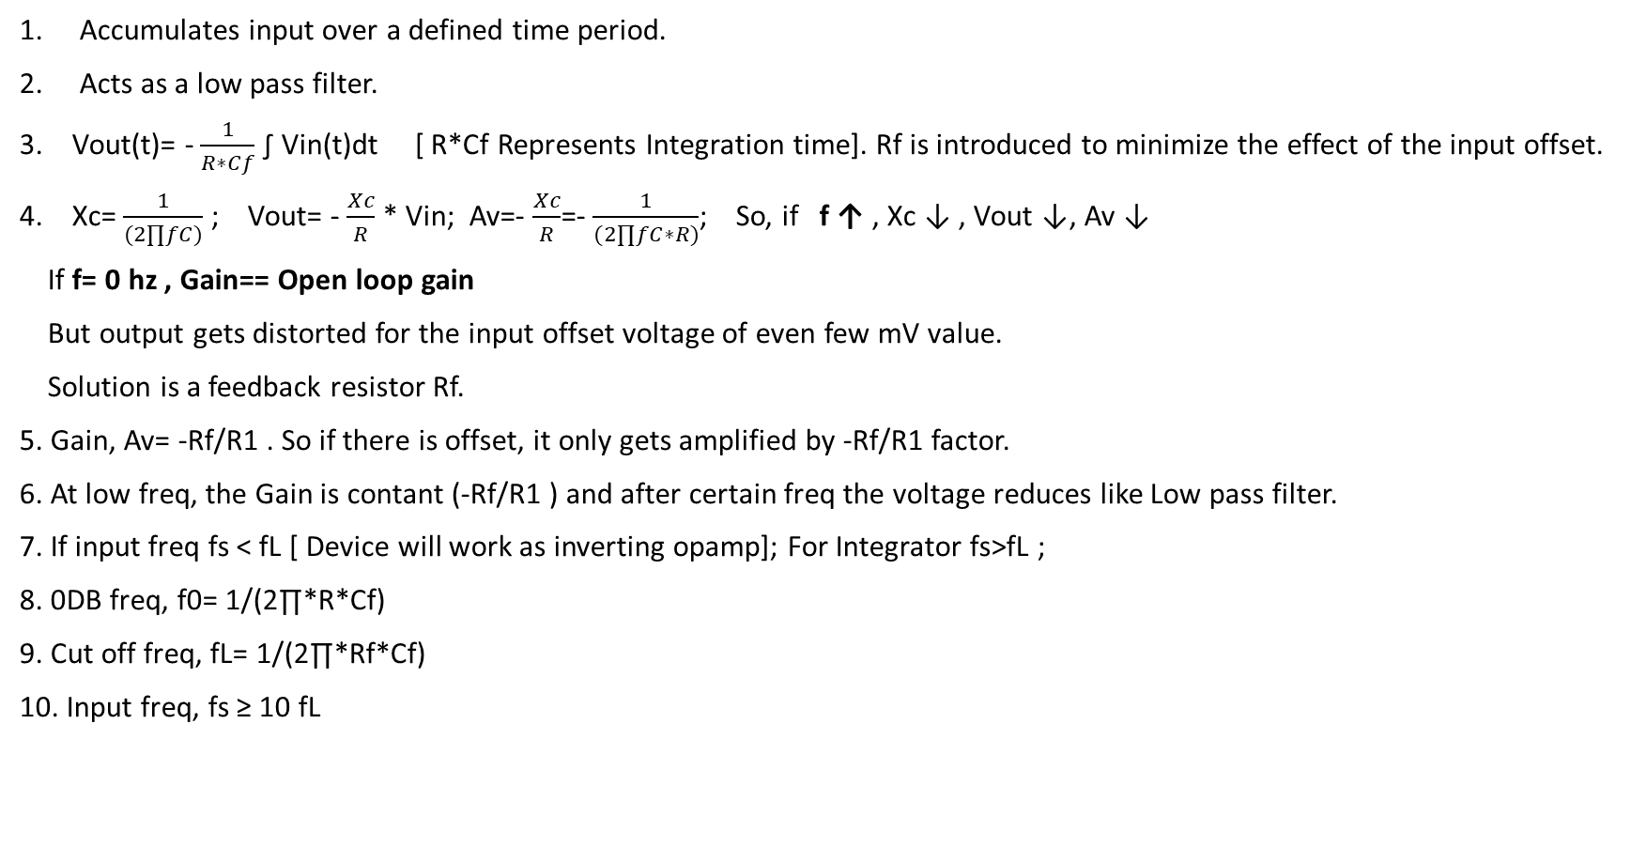
INTEGRATOR

Slide 8
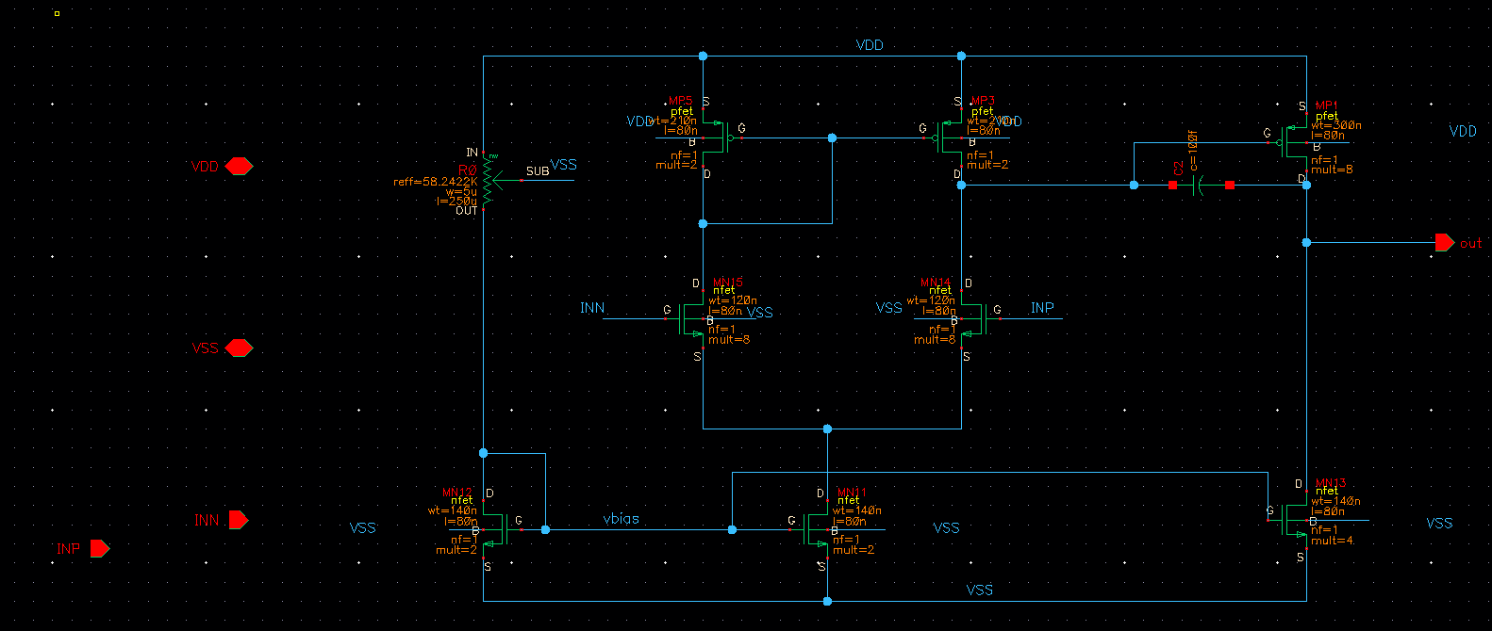
INTEGRATOR
Design considerations:
1. Make sure the FETS of the OpAmp are in saturation.
2. The input offset of the opamp is close to zero volt.
3. The OpAmp gain is high.
4. An input Bias voltage should be introduced at the positive input.

Slide 9
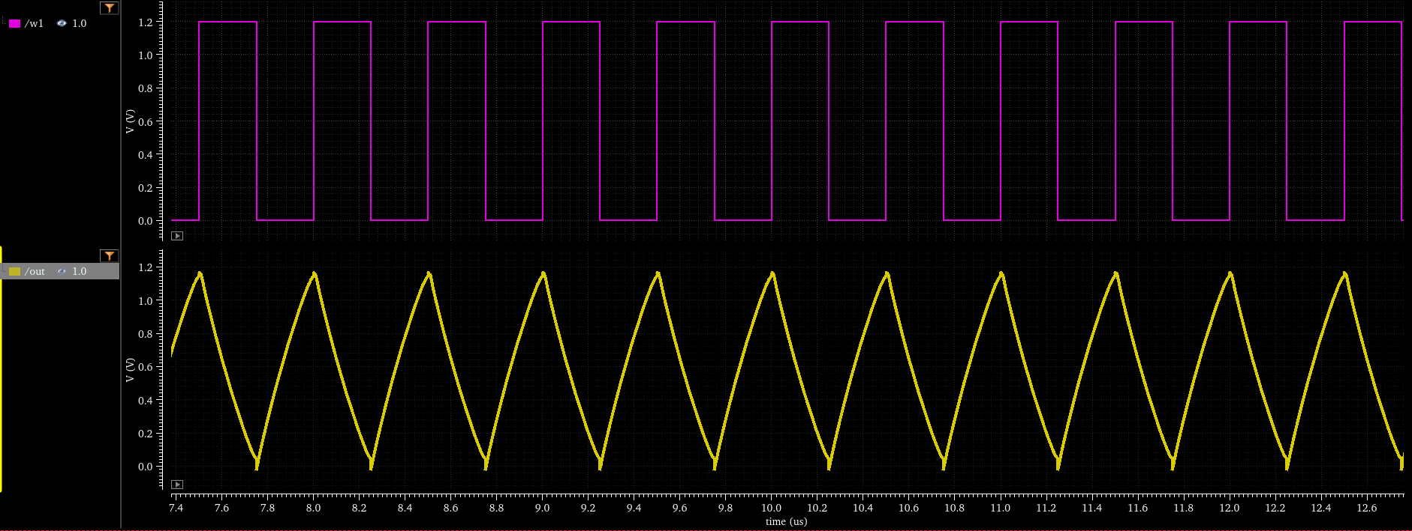
INTEGRATOR OUTPUT
Vout(t)= - 1/(R∗Cf) ∫ Vin(t)dt
If Vin is positive, vout will ramp down and vice versa.
The circuit has the transfer function of an inverting integrator with the gain constant of -1/RC.
The minus sign ( – ) indicates a 180º phase shift because the input signal is connected directly to the inverting input terminal of the operational amplifier.

Slide 10
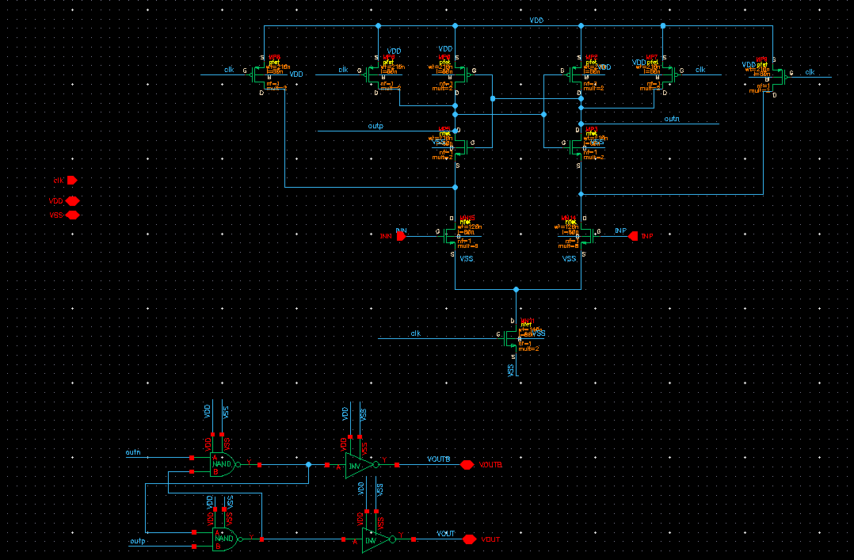
CLOCKED COMPARATOR
Working principle:
1. The basic latch is formed by the cross coupled inverters.
2.When current starts flowing, all nodes in that branch also starts discharging. So the charges gets reduced.
3. If Vip > Vin == Ip >In
4. Right side discharges more rapidly the left.
5. When Clk=1 , two inputs are compared.
6. Clk acts for the Reset phase.
When, Clk=0 it pulls branch to VDD.
Tails mosfet turns off,
Device stops to work as a Diff Amp.
7. The latch below is added to keep the output latched for the positive clock edge.

Slide 11
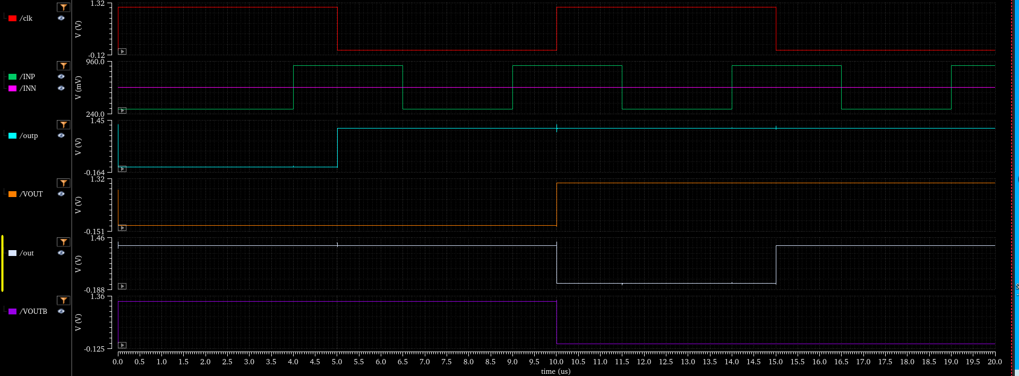
CLOCKED COMPARATOR OUTPUT

Slide 12
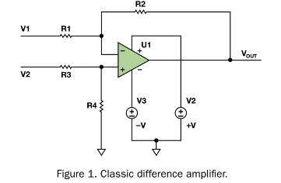
DIFFERENCE AMPLIFIER
Difference amplifier: Provides the output equal to the exact difference of the two input voltages.
Differential amplifier: Provides the output proportional to the difference of the input voltages.
Here we used rail to rail differential amplifier for designing Delta (Difference amplifier) .
Design Considerations:
Make sure the FETS of the Op-Amp are in saturation.
Difference amplifier

Slide 13
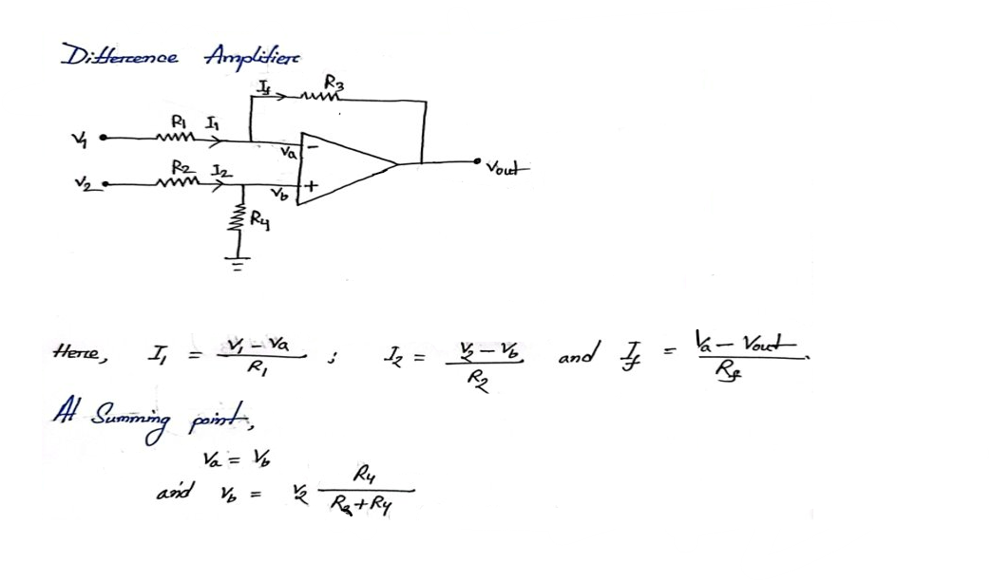
DIFFERENCE AMPLIFIER

Slide 14
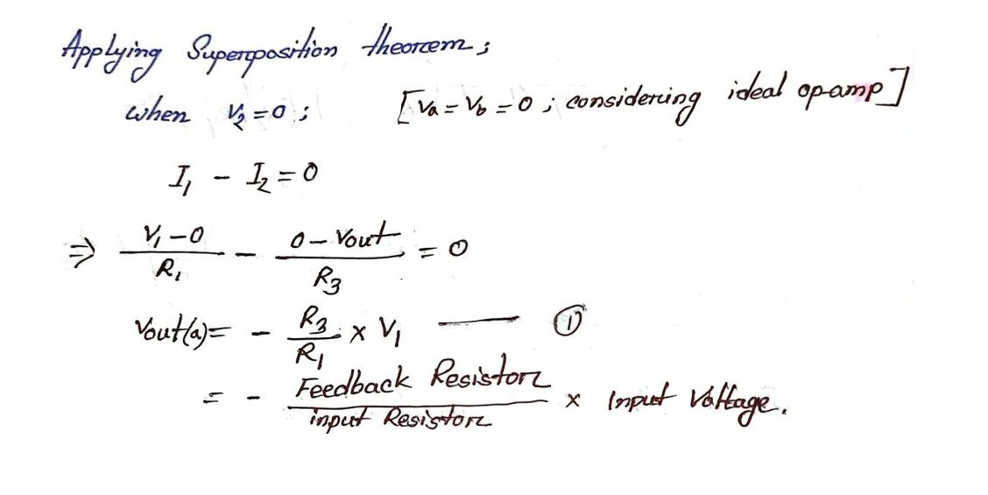
DIFFERENCE AMPLIFIER

Slide 15
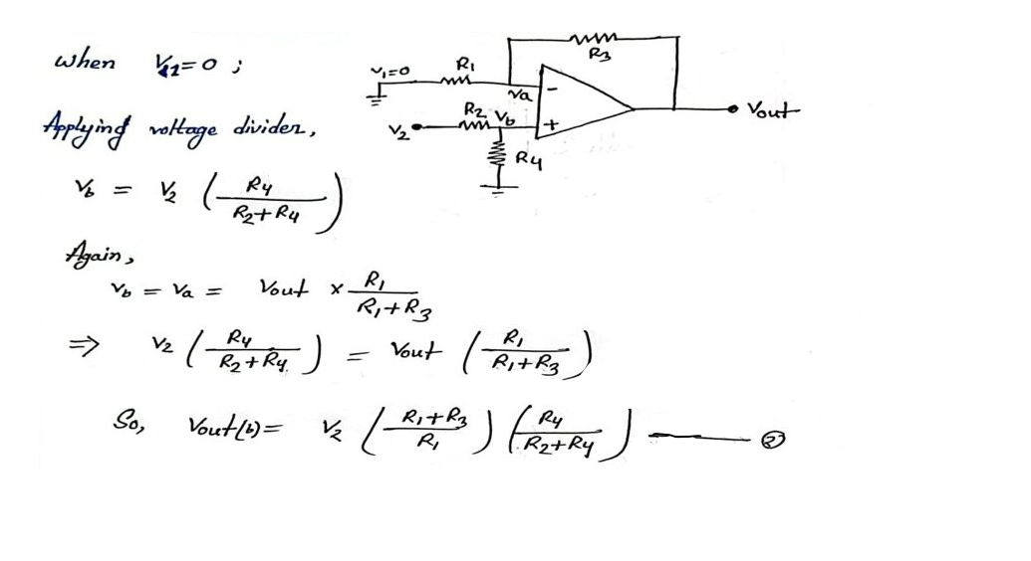
DIFFERENCE AMPLIFIER

Slide 16
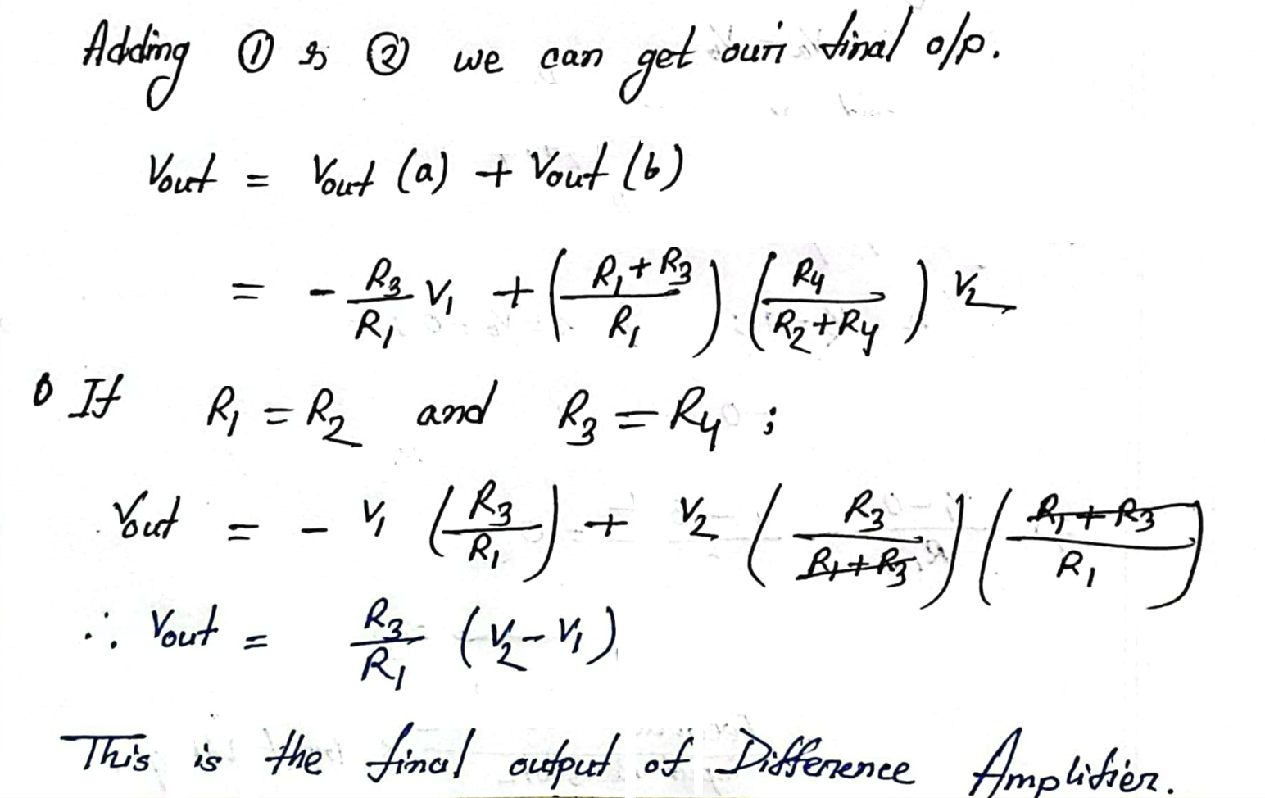
DIFFERENCE AMPLIFIER

Slide 17
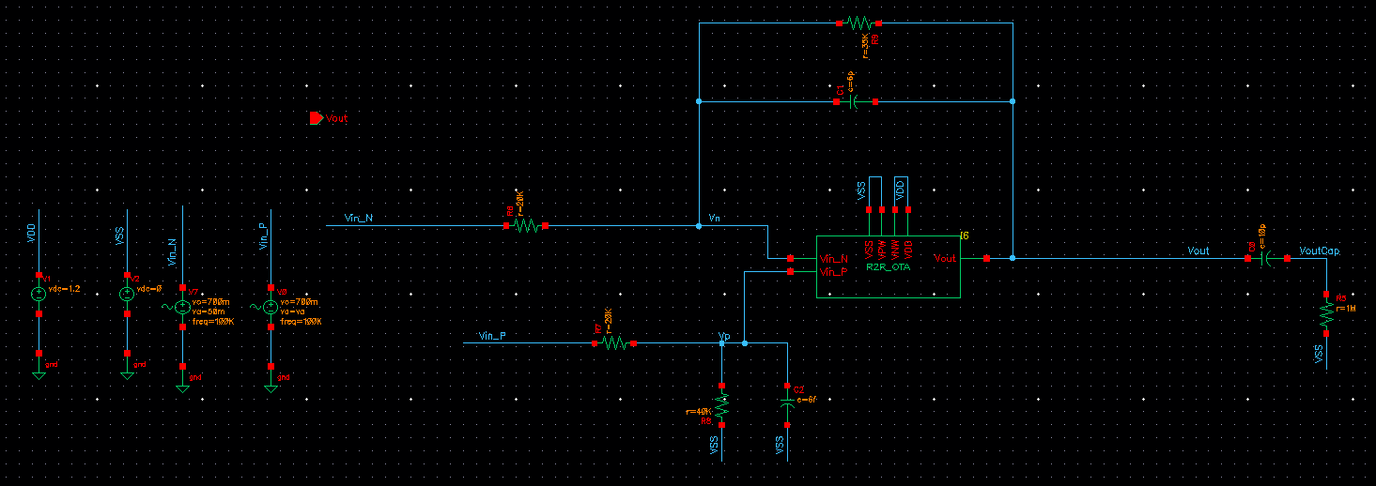
DIFFERENCE AMPLIFIER

Slide 18
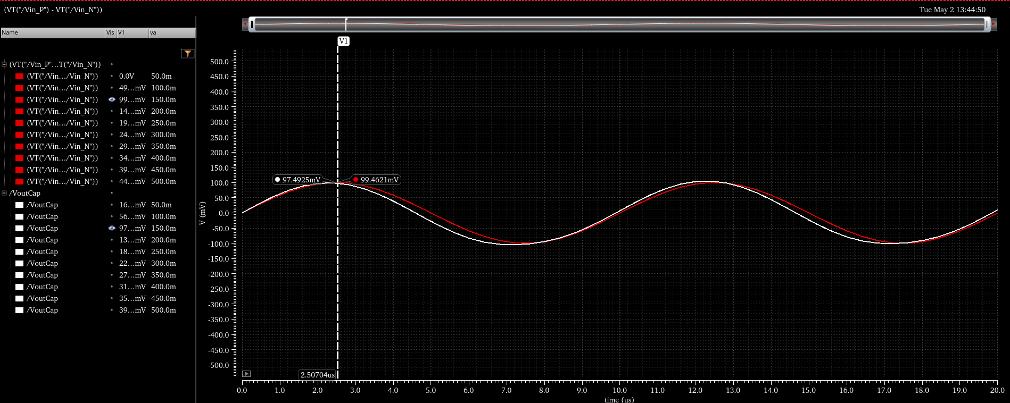
DIFFERENCE AMPLIFIER OUTPUT

Slide 19
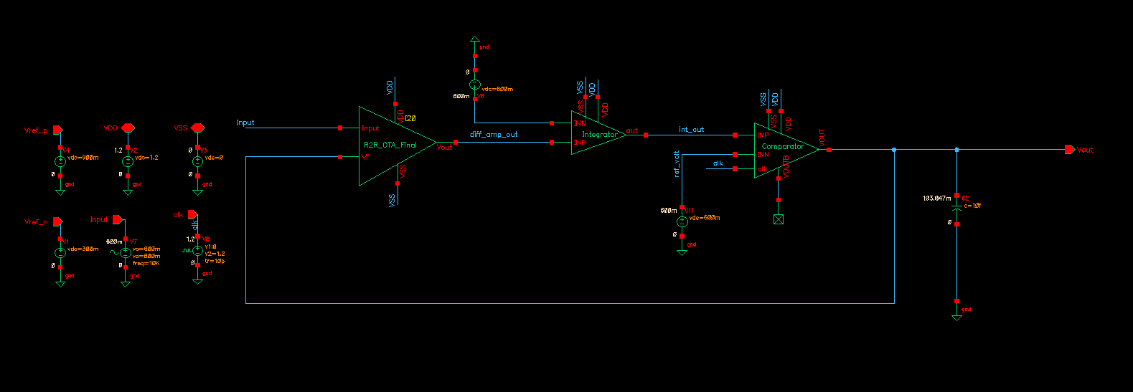
SCHEMATIC OF OUR SIGMA DELTA MODULATOR

Slide 20
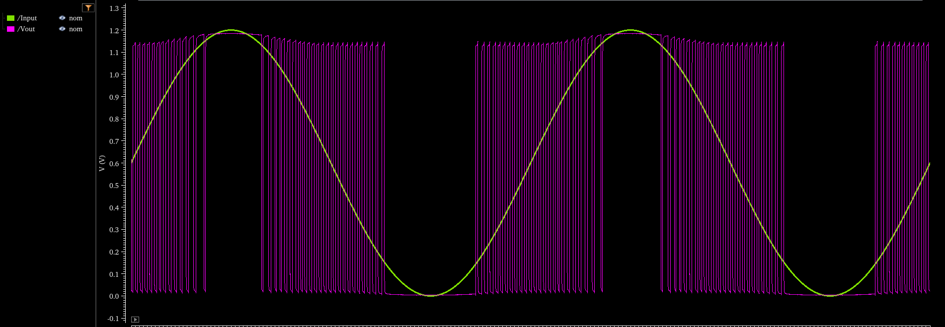
SIGMA DELTA ADC OUTPUT

Slide 21
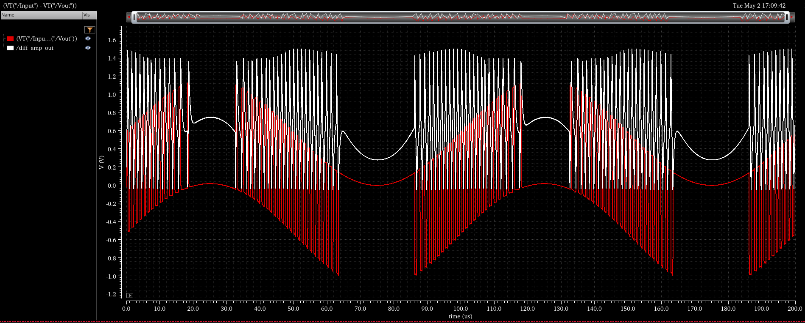
SIGMA DELTA MODULATOR OUTPUT

Slide 22
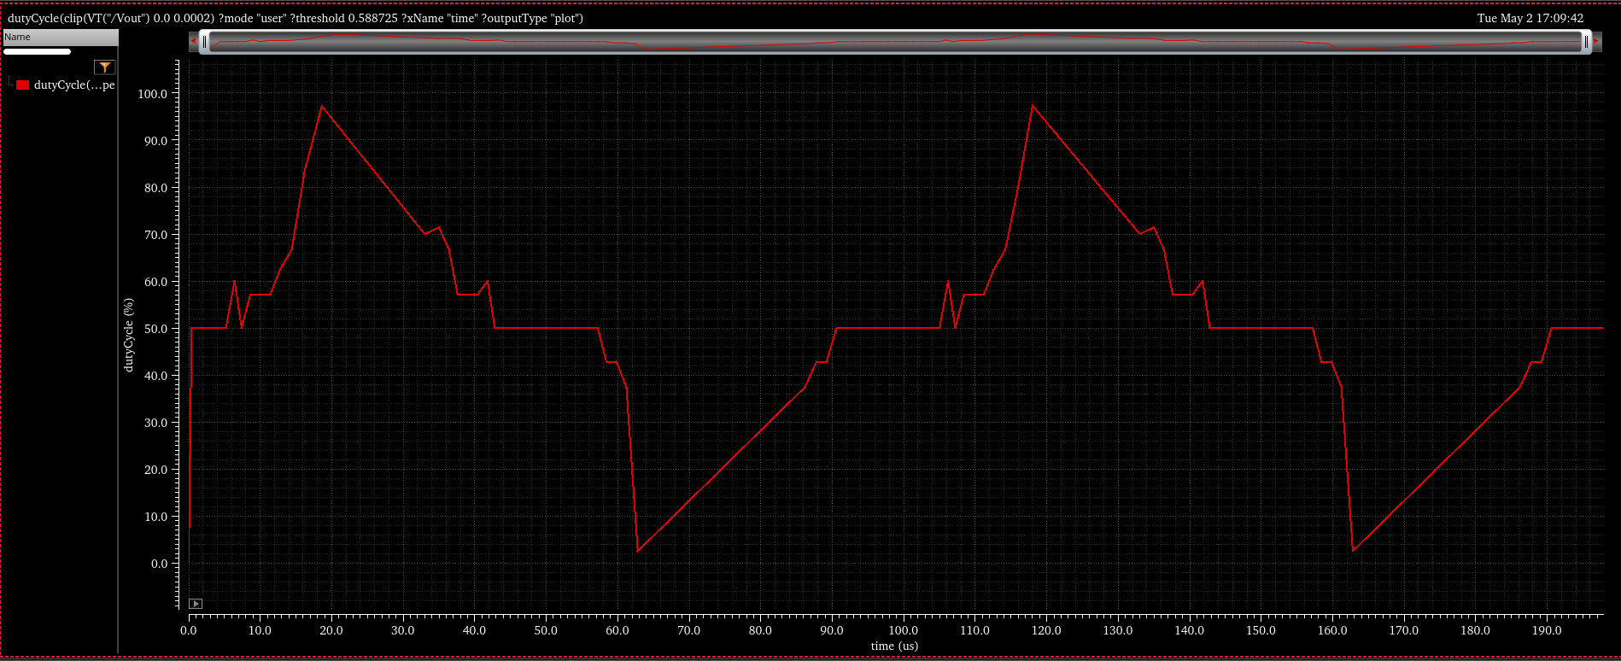
SIGMA DELTA MODULATOR OUTPUT

Slide 23
PROBLEMS AND FINDINGS
Problem 01: Initially, we used a conventional differential amplifier to design the difference amplifier. However, this resulted in a limited output range between 0.6V and 1V, which did not meet our expectations for proper functionality.
Solution 01: To resolve this, we replaced the conventional differential amplifier with a rail-to-rail differential amplifier for the difference amplifier design. This change allowed us to achieve the desired output range, enabling accurate calculation of the difference between the two inputs. Although there were still minor errors caused by RC mismatch, we resolved these issues through trial-and-error adjustments to match the RC values.
Problem 02: Ideally, the offset in an integrator should be zero. However, due to slight mismatches in the load pair of the differential amplifier and the RC values, an offset was introduced, leading to significant distortion in the integrator's output.
Solution 02: To address this, we applied proper biasing to the circuit by supplying a 600 mV biasing voltage to the negative terminal of the differential amplifier. This effectively minimized the offset and corrected the distortion in the output.

Slide 24
PROBLEMS AND FINDINGS
Problem 03 : Another issue we encountered while designing the integrator circuit was that the capacitor acted like a short circuit at high frequencies, causing the output to follow the input. As a result, the integrator failed to function correctly at high frequencies.
Solution 03: To solve this, we adjusted the feedback resistor (increased its value) and reduced the capacitor value, ensuring that at the operating frequency, no short path was created between the input and output. Additionally, we maintained the sampling frequency f_{s} to be at least 10 times greater than the lower frequency limit f_{L}, which helped prevent high-frequency issues.

Slide 25
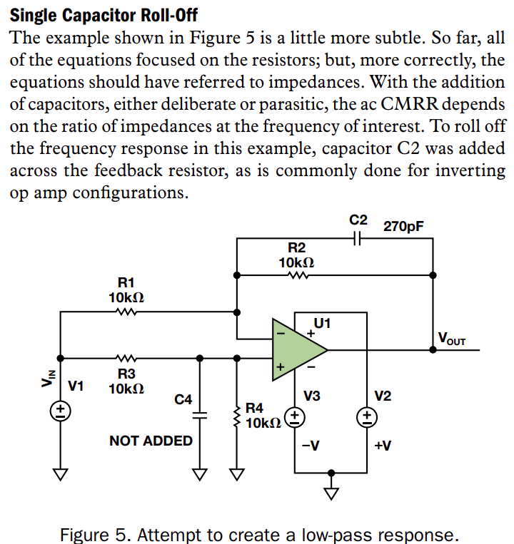
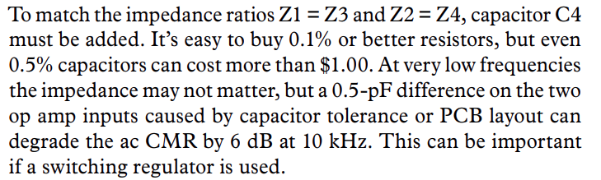
PROBLEMS AND FINDINGS

Slide 26

References
For understanding difference amplifier
https://www.electronics-tutorials.ws/opamp/opamp_5.html
https://www.analog.com/media/en/analog-dialogue/volume-48/number-1/articles/deeper-look-into-difference-amplifiers.pdf

